Slide 1
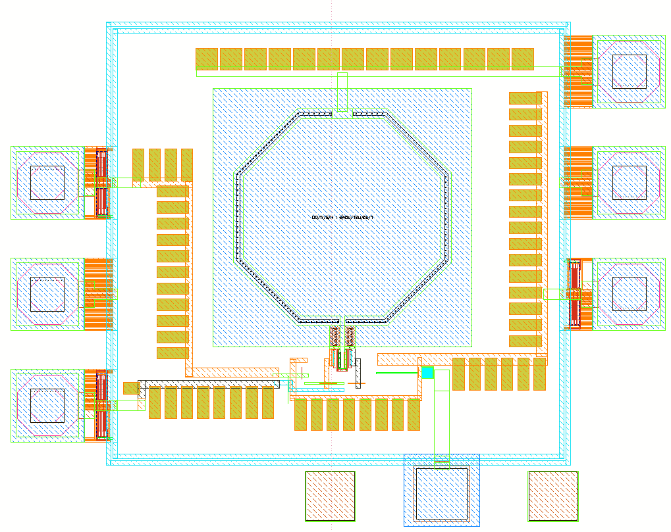
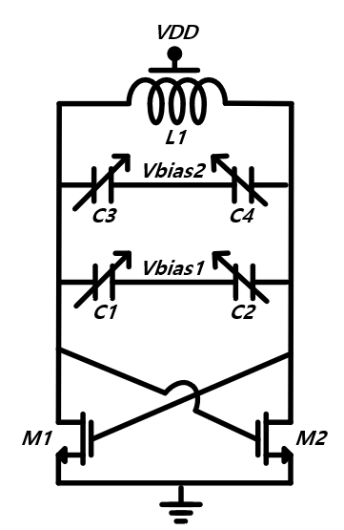
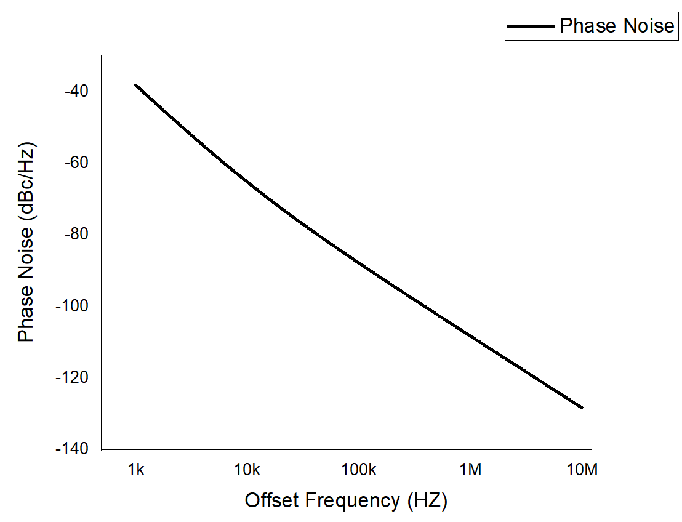


Design of Low Noise and Wideband VCO Using 28-nm CMOS Technology
Jae Hyun Park, Dong Yeol Yang and Byung-Sung Kim
RF Microelectronic Design Lab., Sungkyunkwan University, Suwon 440-746, Korea
Abstract
We propose a Low Noise and wideband VCO in 28-nm CMOS process. The VCO includes a two varactors that control to frequency at 14.7 GHz ~ 17.3 GHz and has phase noise of 108.2 dBc/Hz at 1 MHz offset frequency
I. Introduction
The FMCW(Frequency Modulated Continuous-Wave) radars play an important role in various applications. FMCW radars are generated by PLL(Phase Lock loop). FMCW signal is required to have fast chirp and high chirp linearity. To make a that property, VCO(Voltage Controlled Oscillator) is a key circuit. In this paper, We propose Low Noise and Wideband VCO 28-nm CMOS process.
II. Description
The proposed VCO consists of two different size of varactors using TPM(two point modultaion) PLL topology. The $K_{VCO}$ of bigger size varactors is 2.6 GHz/V and small size varactors is 117 MHz/ V.
III. Simulation Results
Fig. 2 show the chip photograph of VCO. The overall chip size is 650 um * 500 um. Fig. 3 shows simulation result. VCO shows Phase noise of -108.2 dBc/Hz at 1 MHz offset frequency and oscillates at 14.7 GHz ~ 17.3 GHz
Fig. 2. Chip photograph
Fig. 1. Schematic of VCO
Fig. 3. Phase Noise of VCO
IV. CONCLUSION
This paper demonstrated VCO using Samsung 28-nm CMOS. The VCO occupies 0.65mm× 0.5 mm². Phase noise of 108.2 dBc/Hz at 1 MHz offset frequency.
Acknowledgement
This material is based upon work supported by the Ministry of Trade, Industry & Energy(MOTIE, Korea) under Development Program of Next-Generation Intelligent Semiconductor Technology (Design and Manufacturing). No.20009868, Development of 120GHz light-weight low-power Radar SoC for OMS(Occupancy Monitoring System).

